Slide 1
COA123 Web Programming
Welcome!
Topic 1
Module Overview Introduction to HTML & JavaScript

Slide 2
Learning outcome
Module overview
structure of this module
Assessment
Resources
Introduction to HTML
Tags, attributes, class/ID selector, CSS etc.
JavaScript Basics
Output messages
Get data from the user
Use of variables & data types
Math operators & functions

Slide 3

World Wide Web (WWW)
Communication and information
Widely accessible
Platform independent
Multimedia delivery
• ….
Education
E-commerce
Social networks
Entertainment
Research
• ….

Slide 4




WWW: Client – Server architecture
Internet LAN/WAN
URL
Web pages
TCP/IP, HTTP/FTP
Web Server
Client browsers
Client sends URL via HTTP (Hypertext Transfer Protocol) to servers
Server responds with the requested web page (or error message)
Page is written using HTML (Hyper Text Markup Language), JavaScript, etc.
Client browser renders returned web page
The entire system runs on networking protocols (e.g. TCP/IP) over Internet (LAN/WAN)

Slide 5

Web Programming
PHP
DHTML/CSS
jQuery
JavaScript
AJAX (GET/POST)
MySQL
JSON
Forms
Client-server web programming

Slide 6
Main elements
DHTML: interactive and animated websites
–HTML: markup language
–CSS (cascading stylesheets): specify presentation
–JavaScript: client-side scripting language for user interaction
–Document Object Model (DOM): programmatic access to each web elements via a tree structure
–PHP: server-side programming
–MySQL: database
–JQuery/AJAX/Json: smart data/page exchanges

Slide 7
What I know about ...?
(D)HTML/CSS
Javascript
jQuery
PHP
mySQL
JSON
AJAX
self-rating:
Nothing
Read a bit
Module taught
Expert

Slide 8
Software
Windows:
Notepad++
WinSCP (SFTP client)
Firefox (Firebug)
Other tools (option):
TextWrangler (Mac)
Cyberduck (Mac SFTP)
DreamWeaver (Win/Mac)

Slide 9


Resources
Theory, examples
JS/DHTML/PHP tester
Practices
Learn
Lecture slides, lab worksheets, indicative answer
In-lab test, coursework

Slide 10


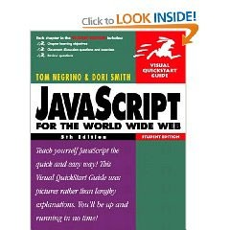



Resources- JS/DHTML
Plenty of online material
W3schools: here
Codecademy: here
MDN JS Web Docs: here
no specific textbooks
University library
JavaScript here
DHTML here
HTML here

Slide 11

Practise & enjoy

Slide 12

Topic 1: Introduction
HTML/CSS, JavaScript (Write your own homepage)

Slide 13
Basic HTML Structure
<html>
<head>
.
.
</head>
<body>
.
.
</body>
</html>
Each .HTML has a head and a body.
Head: title, CSS, JavaScript, etc.
Body: headings, paragraphs, forms
<!-- html comment -->
W3school

Slide 14

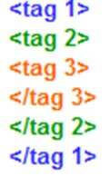
HTML Tags
http://www.w3schools.com/tags/
Also referred to as elements
presented by start/closing angle brackets
<h1>This is a Heading</h1>
…but some are not paired!
New line <br/>, <hr/>
They are nested

Slide 15
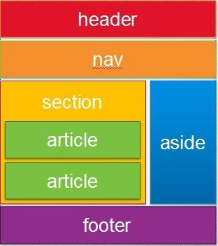
Block Level & Inline Tags
Block <div> …. </div>
Start new lines of text
Contain other tags, e.g. <div> ,
<p>, inline tags
Style them with CSS or to perform certain tasks with JavaScript.
Inline tags
to enhance text, e.g. <strong>, <em>, <span>
Do not start new lines
Generally can contain only other inline tags and text

Slide 16
T1.HTM : HTML TAGS
<!DOCTYPE html>
<html>
<head>
<title>t1</title>
</head>
<body>
<h1>First HTML</h1>
<p>Not too hard</p>
<div>div is a block level tag whereas this is <strong> an inline
</strong> tag. </div>
<table border='1'>
<tr><td>(0,0)</td><td>(0,1)</td></tr>
<tr><td>(1,0)</td><td>(1,1)</td></tr>
</table>
</body>
</html>

Slide 17
HTML List & table
HTML List
http://www.w3schools.com/html/html_lists.asp
<ul> <ol> <li>
HTML table
– examples: https://www.w3schools.com/html/html_tables.asp
– <table> Tag
http://www.w3schools.com/tags/tag_table.asp
<table>, <tr> <th> <td>

Slide 18
HTML attributes
Elements/tags can have a list of attributes, values are enclosed in quotes
<p name=“myPara" id=“Para1"> …. </p> Images:
<img src=" smiley.gif" alt="Smiley face" height="42" width="42">
Links
<a href="http://www.lboro.ac.uk/">Loughborough</a>

Slide 19
CLASS SELECTOR
Specify a style for sub-set instances of HTML tags.
Defined with a "."
selector. classname {property1: value1; property2: value2;}
p.special {text-align: right; color: green;}
Assign to tag of a class: class=“classname"
<p class="special">A different class of paragraph </p>

Slide 20

ID SELECTOR
Apply styles to a single element in the page
– an ID is unique
Similar syntax as class
slector#idname
id="idname"
#myid
{font-style:
italic;font-weight:
bold;}
<p>The
<span
id="myid">Important</span>bit
of…</p>

Slide 21
CSS (Cascading Style Sheets)
<style type="text/css"> h1
{ color:red;
background-color:yellow;
}
.hilite
{
}
table .hilite
{ background-color:green;
}
color:blue;
</style>
CSS specifies style rules in the <head> section
Each rule is made up of a selector, e.g. tags, class, id
/* CSS COMMENTS */
Ref: http://www.htmlhelp.com/reference/css/

Slide 22
t2.htm : CSS
<!DOCTYPE html>
<html>
<head>
<title>t2: ,CSS styles </title>
<style type="text/css">
h1 {color:red; background-color:yellow;}
.hilite {color:blue;}
table .hilite {background-color:green;}
</style>
</head>
<body>
<h1>First HTML</h1>
<p>Not too hard</p>
CSS Reference
<div>div is a block level tag whereas <span class="hilite">is an inline tag</span></div>
<table border='1'>
<tr><td>(0,0)</td><td><span class="hilite">(0,1)</span></td></tr>
<tr><td>(1,0)</td><td>(1,1)</td></tr>
</table>
</body>
</html>

Slide 23

Forms
Forms allow user to enter data
The data can be passed to the server
Require container objects to collect the data
<form
<input
<input
name="f"> name="t"
type='text' />
type='button'
value="Press" />
</form>

Slide 24
t3.htm : Forms
<body>
<h1>First HTML</h1>
<p>Not too hard</p>
<div>div is a block level tag whereas
<span class="hilite">is an inline tag</span></div>
<table border='1'>
<tr><td>(0,0)</td><td><span class="hilite">(0,1)</span></td></tr>
<tr><td>(1,0)</td><td>(1,1)</td></tr>
</table>
<form name="f">
<input name="t" type='text' />
<input type='button' value="Press" />
</form>
</body>
</html>
<!DOCTYPE html>
<html>
<head>
<title>t3</title>
<style type="text/css">
h1 {color:red; background- color:yellow;}
.hilite {color:blue;}
table .hilite {background-color:green;}
</style>
</head>

Slide 25
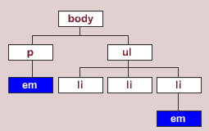
JavaScript (JS)
JavaScript is code run at the browser (client- side)
Usually placed in the <head> section
– Can be inline within container objects
Can access the DOM (Document Obj. Model )
<script type="text/javascript"> function doClick()
{
alert(document.f.t.value);
}

Slide 26
t4.htm : JavaScript
<body>
<h1>First HTML</h1>
<p>Not too hard</p>
<div>div is a block level tag whereas <span class="hilite">is an inline tag</span></div>
<table border='1'>
<tr><td>(0,0)</td><td><span class="hilite">(0,1)</span></td></tr>
<tr><td>(1,0)</td><td>(1,1)</td></tr>
</table>
<form name="f">
<input name="t" type='text' />
<input type='button' value="Press" onclick="doClick();"/>
</form>
</body>
</html>
<!DOCTYPE html>
<html>
<head>
<title>t4</title>
<style type="text/css">
h1 {color:red; background- color:yellow;}
.hilite {color:blue;}
table .hilite {background-color:green;}
</style>
<script type="text/javascript">
function doClick(){ alert(document.f.t.value);
}
</script>
</head>

Slide 27
PHP (Personal Hypertext Preprocessor)
Access databases/files on server
Code is executed at the server running PHP (server-side)
Output from PHP goes into the html document replacing the PHP codes - Preprocessor!
<?php
$v="from DB";
echo echo
"<p>This came from PHP</p>"; "<input name='t' type='text’
value='$v' />";
?>

Slide 28
t5.php (t5.txt)
<html>
<head>
<title>t5</title>
<meta http-equiv="Content-Type" content="text/plain; charset=UTF-8" />
<style type="text/css">
h1 {color:red; background-color:yellow;}
.hilite {color:blue;}
table .hilite {background-color:green;}
</style>
<script type="text/javascript"> function doClick(){
alert(document.f.t.value);
}
</script>
</head>
<body>
<h1>First HTML</h1>
<p>Not too hard</p>
<div>div is a block level tag whereas <span class="hilite">is an inline tag</span></div>
<table border='1'>
<tr><td>(0,0)</td><td><span class="hilite">(0,1)</span></td></tr>
<tr><td>(1,0)</td><td>(1,1)</td></tr>
</table>
<form name="f">
<?php
$v="from DB";
echo "<p>This came from PHP</p>";
echo "<input name='t' type='text' value='$v' />";
?>
<input type='button' value="Press" onClick="doClick();"/>
</form>
</body>
</html>
PHP tester

Slide 29
JavaScript Basics
Output messages
Get data from the user
Use of variables & data types
Math operators & functions

Slide 30

JavaScript
Mostly used programming language of HTML & Web.
It can:
add on interactive HCI features
change attributes and styles
send HTTP requests behind the scenes (AJAX)
… produce dynamic HTML page !
Light bulb demo
Game demo
Complete JS Reference at W3S

Slide 31
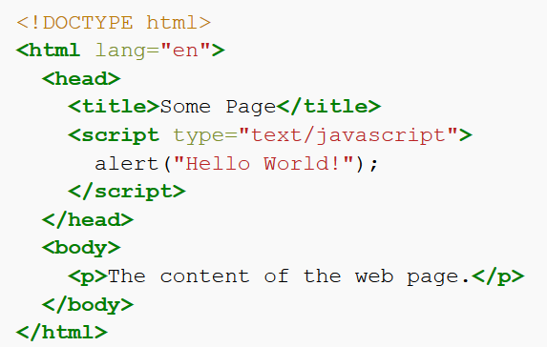
First HTML/JS Program
alert("Hello World!");
JS-htm-HelloWorld.htm
Client-side JS must be placed inside a <script> element in HTML

Slide 32
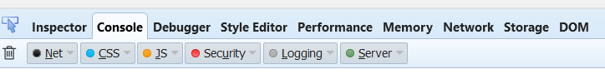
Output a message
1.1 - output
alert (“Hello, world!”);
•strings with single ‘ …’ or double “…” quotes
•escape character \
alert("He said \"GOOD\". ");
// comment to end of line
•/* ….. */ comment in between
•syntax errors : JS console (F12)

Slide 33
JS sequencing
Denoted by semicolon alert(“Hello,”); alert(“world!”);
Denoted by newline alert(“Hello,”) alert(“world!”);
1.2 - sequencing

Slide 34
Variable
var x;
// declare a variable called x
Use a meaningful name – identifier
Naming rules
can be letters, digits, underscore (_) or $
case sensitive
cannot begin with a digit
cannot use reserved words (e.g. function names)

Slide 35
Declare and assign variables
var x = 42 ;
var name="Tom";
Loosely typed
– do not have to declare the variable using var
It's a good programming practice to declare all variables at the beginning of a script.
1.3 - identifiers, variables,

Slide 36
How to get data from user?
ans=prompt("...message..."); ans=prompt("...message...", "...default...");
var x = prompt(“please give value for x”) ;
Declare a variable called x, and let user enter its value

Slide 37

Tryout: prompt( “ … ”)
var Z1 = prompt('Type any text:'), z1=2, z3;
alert(Z1); alert(z1); alert(z3) alert(prompt("What day is it?","Monday"));
declaring a list of variables with comma separation
1.3 - identifiers, variables,… input

Slide 38
Data types
Strings (a sequence of characters)
var person = "John Doe"; var answer = 'Yes!';
Numbers
var pi = 3.14; // floating var i=10; // integer
others later

Slide 39
We can do stuff with data
Math operators: +, *, -, /, % (modulo operator)
n % d : the remainder of dividing n by d
Get input into a variable: var count = prompt(...);
or in literals: alert(42 * 2);
“+” may do different things based on the type of data
link two strings – concatenated
Math addition
1.6 - arithmetic operators

Slide 40
Try: Dual meaning +
alert("Hello, " + prompt("Enter a name : "));
[ user enter: Tom ] Hello, Tom
alert(3 + prompt("Enter a number: ")); [ user enter: 2 ] 32
Data from the prompt is always treated as a string!
We need to tell the computer that the data should be interpreted as a number! (Type conversion)

Slide 41
Converting strings to numbers
Number(...)
Number("-6.6");
Number("0x10");
Number("6a");
// -6.6
//16, 0x for hexadecimal
// NaN: not a number
parseInt(...)
// less strict than Number
parseInt ("6.6"); //6 parseInt ("0x10"); //16 parseInt ("6a"); //6
1.5 - converting strings to numbers

Slide 42
Try: Sum a input number with 2
var n1 = prompt('number:'); var sum1 = n1 + 2;
var n2 = Number(n1); var sum2 = n2 + 2;
alert('sum1= ' + sum1 + "; sum2= " + sum2);
more concisely..
var n = Number(prompt(“number:”));

Slide 43
summary
Overview
Introduction to HTML
Tags, attributes, class/ID selector, CSS etc.
Introduction to JS
Input/output: prompt(…), alert(…);
Variable var & data types
– Variables：arithmetic operators: +
- * / % (modulo)
Conversion (strings -> numbers): Number(…); parseInt(...)
Math object: Math.sqrt(...), round(...), ceil(...), floor(...),
max(...,...), min(...,...), PI

